Slide 1
Hyperparameter Optimization Via Gradient Descent
Ilya Cable

Slide 2
A quote from Week 5 regarding hyperparameters:
“We can’t assume that we can change one feature at a time to optimize”
Hyper-params are generally not:
Smooth, convex
I wanted to experimentally test this statement
Intuitively doesn’t make sense that RandomSearchCV generally provides the best results
The goal:
Try to improve RandomSearchCV output with G.D.
Won’t find a global minimum, but maybe it can slightly improve the solution?

Slide 3
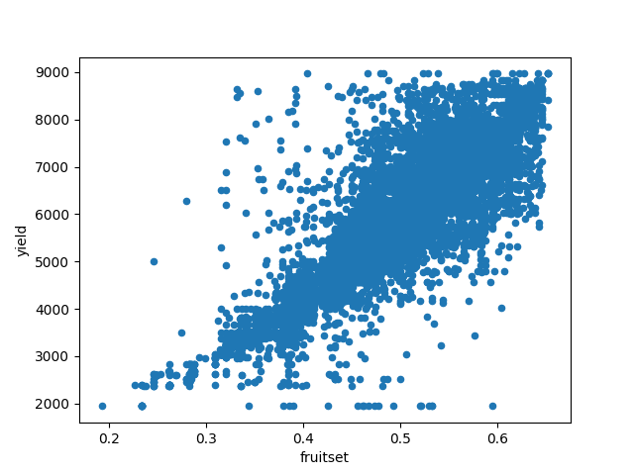
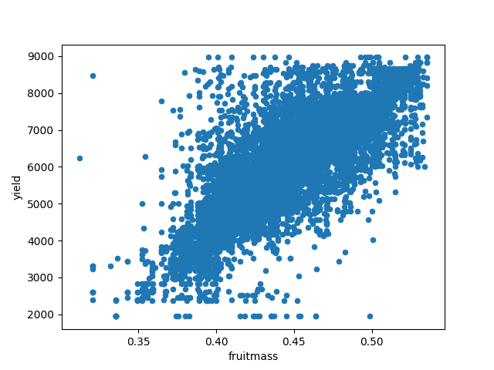
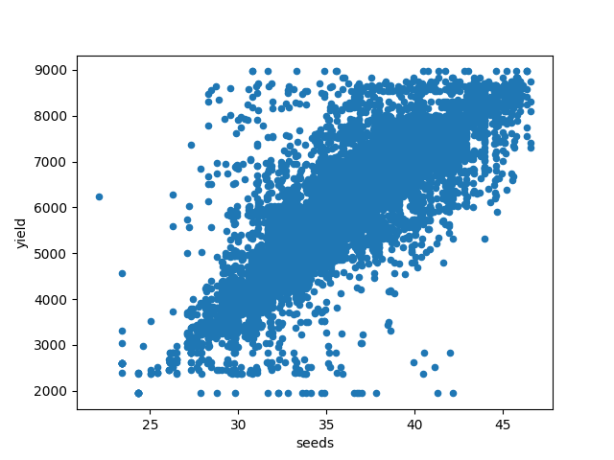
The dataset
Prediction of wild blueberry yield
16 non-target features
3 highly predictive features (fruit set, fruit mass, and seeds):
Scored via MAE (Mean Absolute Error)
Average error between predicted yield and actual yield in lbs

Slide 4
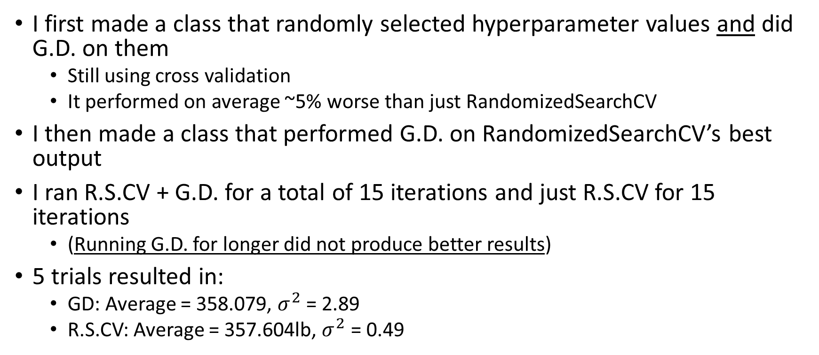
The Results
I first made a class that randomly selected hyperparameter values and did G.D. on them
Still using cross validation
It performed on average ~5% worse than just RandomizedSearchCV
I then made a class that performed G.D. on RandomizedSearchCV’s best output
I ran R.S.CV + G.D. for a total of 15 iterations and just R.S.CV for 15 iterations
(Running G.D. for longer did not produce better results)
5 trials resulted in:
GD: Average = 358.079, $σ^{2}$ = 2.89
R.S.CV: Average = 357.604lb, $σ^{2}$ = 0.49

Slide 5
10 Iterations of R.S.CV
15 Iterations of R.S.CV
Best Result
VS
5 Iterations of G.D.
Output
Output

Slide 6
Challenge Performance
Score: 346.80114
Similar to other GB models
Rank: 1207/1876
Percentile: 64th

